Slide 1
Composition API Part 2

Slide 2
What You Will Learn
Changes w/ Provide-Inject
Hooks / Composables

Slide 3
Changes w/ Provide-Inject

Slide 4
Options usage
Changes w/ Provide-Inject
In Options API, you need to use the provide option on the parent and the inject option in the child component
Same principle applies with the Composition API
Notes:
You still have to provide data from the parent and then inject into the child.
The problem with Options API is that VS Code does not have intellisense support for it

Slide 5
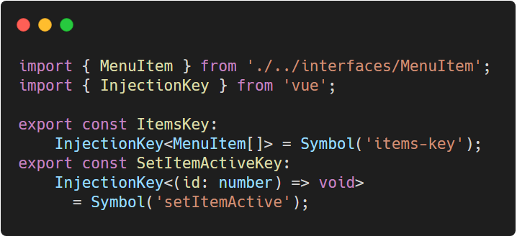
Injection Keys
Changes w/ Provide-Inject
Vue provides an InjectionKey that can be used to sync the type of injected value between provider and consumer
Notes:
InjectionKeys are usually placed inside an external “constants” file
If anyone is getting annoyed by the “possibly undefined”, set strict in tsconfig.json to false
TypeScript: https://carbon.now.sh/?bg=rgba%28255%2C255%2C255%2C1%29&t=vscode&wt=none&l=javascript&ds=false&dsyoff=20px&dsblur=68px&wc=true&wa=true&pv=56px&ph=56px&ln=false&fl=1&fm=Hack&fs=14px&lh=133%25&si=false&es=2x&wm=false&code=import%2520%257B%2520MenuItem%2520%257D%2520from%2520%27.%252F..%252Finterfaces%252FMenuItem%27%253B%250Aimport%2520%257B%2520InjectionKey%2520%257D%2520from%2520%27vue%27%253B%250A%250Aexport%2520const%2520ItemsKey%253A%2520%250A%2509InjectionKey%253CMenuItem%255B%255D%253E%2520%253D%2520Symbol%28%27items-key%27%29%253B%250Aexport%2520const%2520SetItemActiveKey%253A%2520%250A%2509InjectionKey%253C%28id%253A%2520number%29%2520%253D%253E%2520void%253E%2520%250A%2520%2520%2520%2520%2520%2520%253D%2520Symbol%28%27setItemActive%27%29%253B

Slide 6
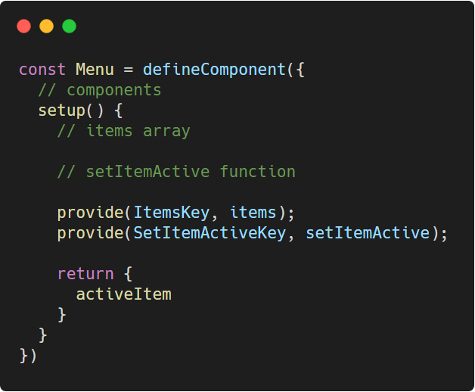
Composition API - Provide
Changes w/ Provide-Inject
provide function takes in a key as the first argument and the actual value on the second.
Notes:
In composition API, we can import provide function from the vue framework
TypeScript: https://carbon.now.sh/?bg=rgba%28255%2C255%2C255%2C1%29&t=vscode&wt=none&l=javascript&ds=false&dsyoff=20px&dsblur=68px&wc=true&wa=true&pv=56px&ph=56px&ln=false&fl=1&fm=Hack&fs=14px&lh=133%25&si=false&es=2x&wm=false&code=const%2520Menu%2520%253D%2520defineComponent%28%257B%250A%2520%2520%252F%252F%2520components%250A%2520%2520setup%28%29%2520%257B%250A%2520%2520%2520%2520%252F%252F%2520items%2520array%250A%250A%2520%2520%2520%2520%252F%252F%2520setItemActive%2520function%250A%250A%2520%2520%2520%2520provide%28ItemsKey%252C%2520items%29%253B%250A%2520%2520%2520%2520provide%28SetItemActiveKey%252C%2520setItemActive%29%253B%250A%250A%2520%2520%2520%2520return%2520%257B%250A%2520%2520%2520%2520%2520%2520activeItem%250A%2520%2520%2520%2520%257D%250A%2520%2520%257D%250A%257D%29

Slide 7
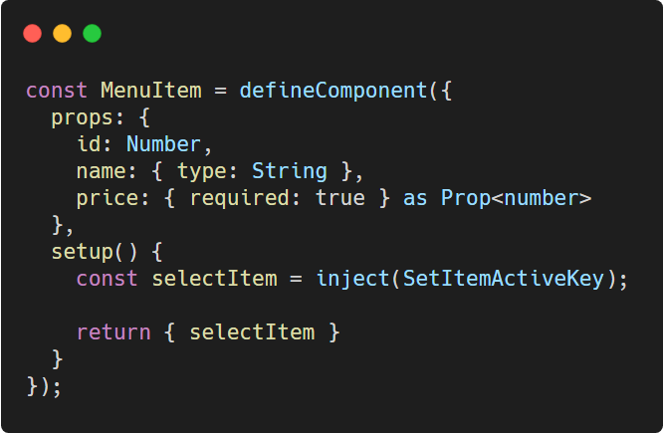
Composition API - Inject
Changes w/ Provide-Inject
Consumer components can then use the inject function which receives the key that was used on provide
Notes:
TypeScript: https://carbon.now.sh/?bg=rgba%28255%2C255%2C255%2C1%29&t=vscode&wt=none&l=javascript&ds=false&dsyoff=20px&dsblur=68px&wc=true&wa=true&pv=56px&ph=56px&ln=false&fl=1&fm=Hack&fs=14px&lh=133%25&si=false&es=2x&wm=false&code=const%2520MenuItem%2520%253D%2520defineComponent%28%257B%250A%2520%2520props%253A%2520%257B%250A%2520%2520%2520%2520id%253A%2520Number%252C%250A%2520%2520%2520%2520name%253A%2520%257B%2520type%253A%2520String%2520%257D%252C%250A%2520%2520%2520%2520price%253A%2520%257B%2520required%253A%2520true%2520%257D%2520as%2520Prop%253Cnumber%253E%250A%2520%2520%257D%252C%250A%2520%2520setup%28%29%2520%257B%250A%2520%2520%2520%2520const%2520selectItem%2520%253D%2520inject%28SetItemActiveKey%29%253B%250A%250A%2520%2520%2520%2520return%2520%257B%2520selectItem%2520%257D%250A%2520%2520%257D%250A%257D%29%253B

Slide 8
Hooks / Composables

Slide 9
Problems w/ the Mixins
Hooks / Composables
While mixins are a very useful mechanism for sharing data and functionality it has drawbacks.

Slide 10
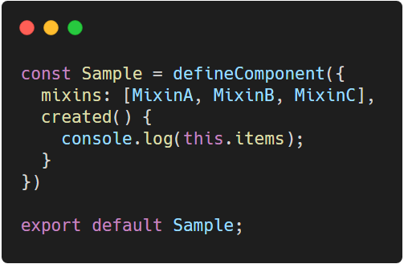
Problems w/ the Mixins
Hooks / Composables
in a component with multiple mixins, it’s not obvious where some values or functions come from
Notes:
Be it data or function, when trying to debug or maintain your code, it’s hard to know which Mixin contains such properties.
TypeScript: https://carbon.now.sh/?bg=rgba%28255%2C255%2C255%2C1%29&t=vscode&wt=none&l=javascript&ds=false&dsyoff=20px&dsblur=68px&wc=true&wa=true&pv=56px&ph=56px&ln=false&fl=1&fm=Hack&fs=14px&lh=133%25&si=false&es=2x&wm=false&code=const%2520Sample%2520%253D%2520defineComponent%28%257B%250A%2520%2520mixins%253A%2520%255BMixinA%252C%2520MixinB%252C%2520MixinC%255D%252C%250A%2520%2520created%28%29%2520%257B%250A%2520%2520%2520%2520console.log%28this.items%29%253B%250A%2520%2520%257D%250A%257D%29%250A%250Aexport%2520default%2520Sample%253B

Slide 11
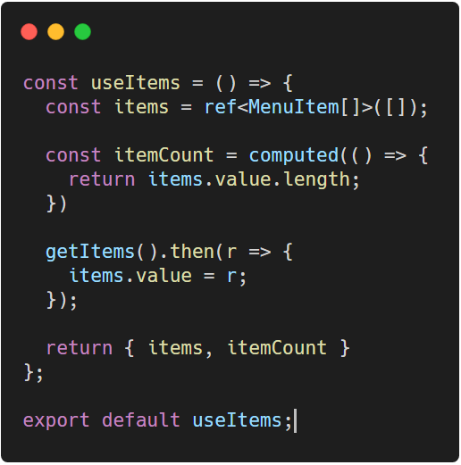
Hooks
Hooks / Composables
Hooks is the replacement for mixins in Composition API and has the advantage of knowing the source
Naming convention of use[HookName]
Notes:
TypeScript: https://carbon.now.sh/?bg=rgba%28255%2C255%2C255%2C1%29&t=vscode&wt=none&l=javascript&ds=false&dsyoff=20px&dsblur=68px&wc=true&wa=true&pv=56px&ph=56px&ln=false&fl=1&fm=Hack&fs=14px&lh=133%25&si=false&es=2x&wm=false&code=const%2520useItems%2520%253D%2520%28%29%2520%253D%253E%2520%257B%250A%2520%2520const%2520items%2520%253D%2520ref%253CMenuItem%255B%255D%253E%28%255B%255D%29%253B%250A%250A%2520%2520const%2520itemCount%2520%253D%2520computed%28%28%29%2520%253D%253E%2520%257B%250A%2520%2520%2520%2520return%2520items.value.length%253B%250A%2520%2520%257D%29%250A%250A%2520%2520getItems%28%29.then%28r%2520%253D%253E%2520%257B%250A%2520%2520%2520%2520items.value%2520%253D%2520r%253B%250A%2520%2520%257D%29%253B%250A%250A%2520%2520return%2520%257B%2520items%252C%2520itemCount%2520%257D%250A%257D%253B%250A%250Aexport%2520default%2520useItems%253B

Slide 12
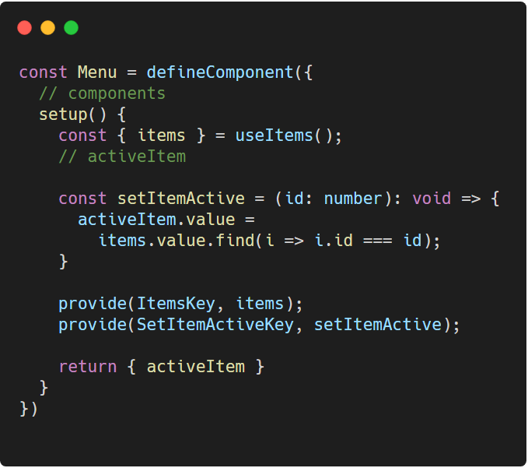
Hooks - usage
Hooks / Composables
The function can then be destructured according to what the component needs
Notes:
Destructuring is an ES6 feature
Do note that we have to replace the items with ref instead of reactive. Why? Because reactive work perfectly only if you don’t have to re-assign values. Whenever you have to re-assign, you need to use refs. This is true for the injection keys as well.
TypeScript: https://carbon.now.sh/?bg=rgba%28255%2C255%2C255%2C1%29&t=vscode&wt=none&l=javascript&ds=false&dsyoff=20px&dsblur=68px&wc=true&wa=true&pv=56px&ph=56px&ln=false&fl=1&fm=Hack&fs=14px&lh=133%25&si=false&es=2x&wm=false&code=const%2520Menu%2520%253D%2520defineComponent%28%257B%250A%2520%2520%252F%252F%2520components%250A%2520%2520setup%28%29%2520%257B%250A%2520%2520%2520%2520const%2520%257B%2520items%2520%257D%2520%253D%2520useItems%28%29%253B%250A%2520%2520%2520%2520%252F%252F%2520activeItem%250A%250A%2520%2520%2520%2520const%2520setItemActive%2520%253D%2520%28id%253A%2520number%29%253A%2520void%2520%253D%253E%2520%257B%250A%2520%2520%2520%2520%2520%2520activeItem.value%2520%253D%2520%250A%2520%2520%2520%2520%2520%2520%2520%2520items.value.find%28i%2520%253D%253E%2520i.id%2520%253D%253D%253D%2520id%29%253B%250A%2520%2520%2520%2520%257D%250A%250A%2520%2520%2520%2520provide%28ItemsKey%252C%2520items%29%253B%250A%2520%2520%2520%2520provide%28SetItemActiveKey%252C%2520setItemActive%29%253B%250A%250A%2520%2520%2520%2520return%2520%257B%2520activeItem%2520%257D%250A%2520%2520%257D%250A%257D%29%250A

Slide 13
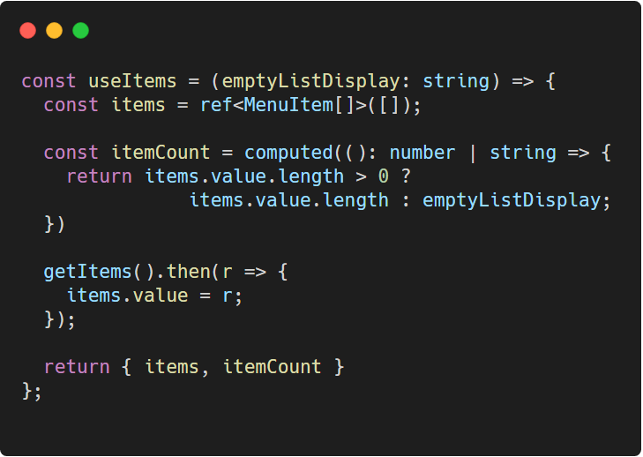
Hooks > Mixins
Hooks / Composables
In hooks, you can send arguments which makes them more configurable than mixins
Notes:
TypeScript: https://carbon.now.sh/?bg=rgba%28255%2C255%2C255%2C1%29&t=vscode&wt=none&l=javascript&ds=false&dsyoff=20px&dsblur=68px&wc=true&wa=true&pv=56px&ph=56px&ln=false&fl=1&fm=Hack&fs=14px&lh=133%25&si=false&es=2x&wm=false&code=const%2520useItems%2520%253D%2520%28emptyListDisplay%253A%2520string%29%2520%253D%253E%2520%257B%250A%2520%2520const%2520items%2520%253D%2520ref%253CMenuItem%255B%255D%253E%28%255B%255D%29%253B%250A%250A%2520%2520const%2520itemCount%2520%253D%2520computed%28%28%29%253A%2520number%2520%257C%2520string%2520%253D%253E%2520%257B%250A%2520%2520%2520%2520return%2520items.value.length%2520%253E%25200%2520%253F%2520%250A%2520%2520%2520%2520%2520%2520%2520%2520%2520%2520%2520%2520%2520%2520%2520items.value.length%2520%253A%2520emptyListDisplay%253B%250A%2520%2520%257D%29%250A%250A%2520%2520getItems%28%29.then%28r%2520%253D%253E%2520%257B%250A%2520%2520%2520%2520items.value%2520%253D%2520r%253B%250A%2520%2520%257D%29%253B%250A%250A%2520%2520return%2520%257B%2520items%252C%2520itemCount%2520%257D%250A%257D%253B%250A

Slide 14
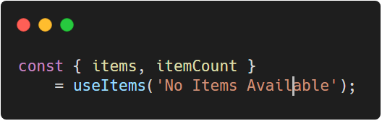
Hooks > Mixins
Hooks / Composables
Hooks also solve the drawbacks of mixins of knowing where the code came from
Notes:
If one is following the naming convention, they could easily tell that such properties come from that specific hook
TypeScript: https://carbon.now.sh/?bg=rgba%28255%2C255%2C255%2C1%29&t=vscode&wt=none&l=javascript&ds=false&dsyoff=20px&dsblur=68px&wc=true&wa=true&pv=56px&ph=56px&ln=false&fl=1&fm=Hack&fs=14px&lh=133%25&si=false&es=2x&wm=false&code=const%2520%257B%2520items%252C%2520itemCount%2520%257D%2520%250A%2509%253D%2520useItems%28%27No%2520Items%2520Available%27%29%253B

Slide 15
Hooks Gotchas
Hooks / Composables
Hooks like mixins do not share data state across components
You can use hooks inside other hooks
While you can modify exposed refs data from a hook, exposing a method to modify it from the hook is better for maintainability purposes.
Notes:
Moving forward, we won’t be using mixins anymore but hooks BUT it is important to know what mixins are since not all projects use the Composition API

Slide 16
Thank You
Up Next . . . Form Components

